Slide 1
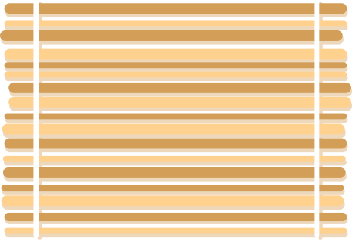
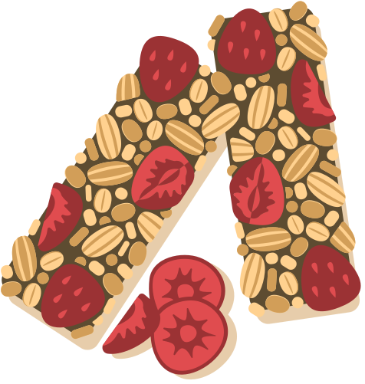




Machine Learning II – Spring 2026
Harleen Buttar, Haiyang Hu, Mohan Li, Skylar Liu
QLoRA Recipe Chef
Controllable recipe generation via parameter-efficient fine-tuning of Qwen 2.5
Notes:
Hi everyone. Today we’re presenting our project of QLoRA Recipe Chef. To be more specific, we fined tune a small language model Qwen 2.5 with Qlora to make it a recipe generator.

Slide 2


Project at a glance
We fine-tuned a 1.5B-parameter LLM into a structured recipe generator using QLoRA — quantized low-rank adaptation. Given a list of ingredients, a cuisine, and a dietary preference, the model produces a complete recipe.
HEADLINE NUMBERS
−77.7%
+58%
↻
Efficient
Only 1.18% of the base model is trainable. Whole run fits well under 5 GB VRAM.
Perplexity reduction
(12.20 → 2.72)
ROUGE-L vs base
(0.16 → 0.26)
◇
Controllable
Recipes condition on a cuisine tag and a diet tag, both injected at training time.
0.97
95%
◎
Measured
5 metrics, 3 baselines, 1 rank ablation — not just one ROUGE score.
Ingredient fidelity
vs 0.83 baseline
General knowledge
retention (vs 90%)
QLoRA Recipe Chef | Machine Learning II — Final Project
2 / 16
Notes:
Before we get into the details, let’s take a look at the project in one slide.
On the left, three things make this project stand out. First, it is efficient. We only train 1.18% of the model. The whole training run uses less than 5 gigabytes of GPU memory. Second, it is controllable. The model takes a cuisine tag and a diet tag, so users can steer the output. Third, we measured it carefully. We have five metrics, three baselines, and a rank ablation.
On the right are the numbers from our evaluation. Perplexity drops by 77%. ROUGE-L goes up by 58%. Ingredient fidelity hits 0.97. And general knowledge actually improves, from 90 to 95%.
We will explain each of these numbers later.

Slide 3


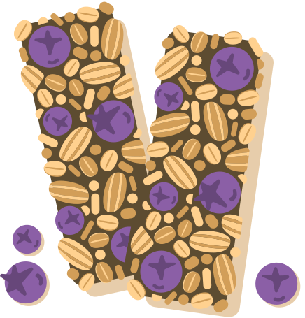
What we built
CONCISE DESCRIPTION
A controllable recipe-generation model:
EXAMPLE INPUT → OUTPUT
Base model: Qwen 2.5-1.5B-Instruct (Apache 2.0)
Method: QLoRA — 4-bit NF4 quantized base + trainable low-rank adapters
Data: skadewdl3/recipe-nlg-llama2 (2.23M recipes; we use 20K)
Our extension: cuisine + dietary conditioning at training time
INPUT
Ingredients: chicken breast, garlic, lemon,
rosemary, olive oil
Cuisine: Mediterranean
Diet: omnivore
OUTPUT
Inspired by Daniel-Krasik/Qwen2.5-1.5B-QLoRA-Recipe (Hugging Face).
Title: Lemon Rosemary Chicken
Ingredients:
- chicken breast
- olive oil
- garlic
- rosemary
- lemon
Directions:
Heat oven to 375°F. Place chicken in
roasting pan; season; combine ingredients;
roast until juices run clear.
KEY REFERENCES
• Hu et al. (2021). LoRA: Low-Rank Adaptation of Large Language Models.
• Dettmers et al. (2023). QLoRA: Efficient Finetuning of Quantized LLMs.
• Bień et al. (2020). RecipeNLG: A Cooking Recipes Dataset.
• Qwen Team (2024). Qwen2.5 Technical Report.
QLoRA Recipe Chef | Machine Learning II — Final Project
3 / 16
Notes:
So, what exactly did we build?
The base model is Qwen 2.5, the 1.5 billion parameter instruct version. It is open source and free to use.
The method is QLoRA. That stands for Quantized Low-Rank Adaptation. We will explain how it works in a few slides.
For data, we used a public dataset called recipe-nlg-llama2.
Our extension — the thing that makes this project different from existing models — is the cuisine and diet conditioning. We will get to that later as well.
The example on the right shows what the model does. You give it five ingredients, a cuisine, and a diet. You get back a recipe with the title, the ingredient list, and the directions, all in a clean structured format.

Slide 4
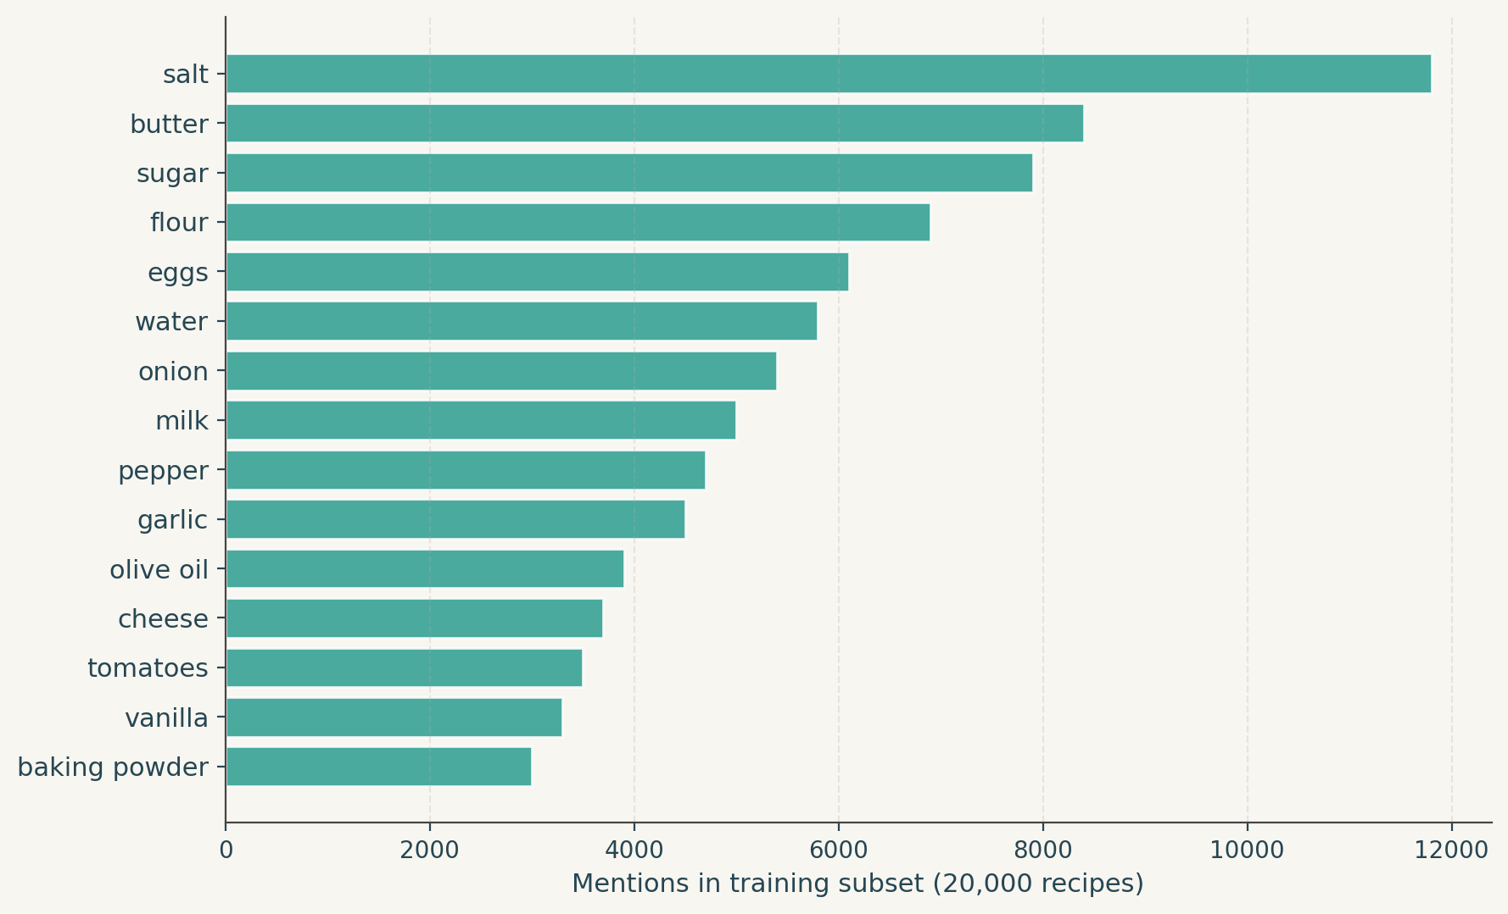
The data — RecipeNLG
DATA DESCRIPTION
skadewdl3 / recipe-nlg-llama2
Most frequent ingredients
A chat-formatted re-pack of the RecipeNLG corpus (Bień et al., 2020).
The corpus skews Western (salt, butter, flour, eggs) — a real limitation we acknowledge in our conclusions.
2.23M
20K
Total recipes
Training subset
500
10,250
Held-out test
Unique ingredients
SCHEMA
title | Recipe name
ingredients | Bulleted ingredient list with quantities
directions | Bulleted cooking steps
NER | Comma-separated ingredient names
source | Gathered or Recipes1M
QLoRA Recipe Chef | Machine Learning II — Final Project
4 / 16
Notes:
Now let’s get into the details.
Our dataset recipe-nlg-llama2, is a chat-formatted version of RecipeNLG, which is a published cooking dataset in 2020.
Some quick numbers — 2.2 million total recipes. We used 20000 for training, 500 for held-out testing, and the corpus has about 10000 unique ingredients.
The schema is simple. Each recipe has a title, a bulleted ingredient list with quantities, a bulleted set of cooking steps, an ingredient name list without quantities, and a source tag.
The chart on the right shows the most common ingredients. You can see that the corpus is very Western — salt, butter, and sugar dominate, which is an limitation of our data. Our model will be better at American or European recipes than, say, Chinese or Korean recipes.

Slide 5
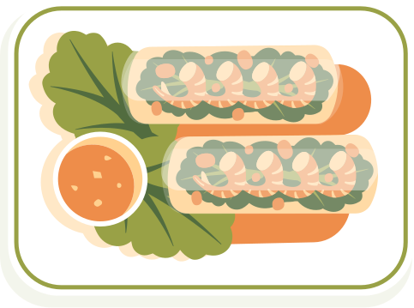
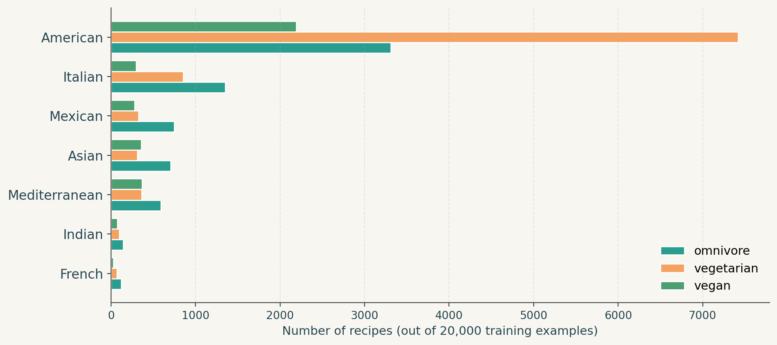
Our extension: cuisine + diet conditioning
DATA DESCRIPTION
The dataset has no cuisine or diet labels, so we created them.
Label distribution (20K training recipes)
Rule-based tagging on each recipe:
CUISINE
Keyword spotting on title + ingredients picks one of 7 cuisines (American, Italian, Mexican, Asian, Indian, French, Mediterranean) — default = American.
DIET
Vegan if no meat / fish / dairy / egg terms; vegetarian if no meat / fish; else omnivore.
WHY THIS IS OUR CONTRIBUTION
The reference model on Hugging Face is unconditioned. Our tags make the model controllable — same ingredients can yield Italian, Mexican, or Indian recipes by changing one input field.
Labels are noisy (rule-based) but diverse — all cuisines and diets are represented, giving the model a signal to learn from.
QLoRA Recipe Chef | Machine Learning II — Final Project
5 / 16

Slide 6

How QLoRA works
KEY COMPONENTS
Frozen pretrained forward path
1
Freeze the base in 4-bit
Load Qwen 2.5-1.5B in NF4 quantization with double-quant. Base weights drop from ~3 GB → ~0.8 GB. The base is NEVER updated.
W₀ (frozen, NF4)
X
h
A
B
2
Add a low-rank update
For each linear projection, learn ΔW = BA, where A is r×k and B is d×r with r=16 — dramatically fewer parameters than W itself.
Trainable LoRA (△W = BA)
PARAMETER ACCOUNTING
3
Train only the adapter
For each adapted matrix: |A| + |B| = r(d + k)
vs full FT: d × k
Result:
18.5M trainable / 1.55B total = 1.18% of the base.
Gradients flow through dequantized W₀ into the bf16 LoRA matrices A and B. 8-bit AdamW optimizer with CPU paging keeps memory low.
QLoRA Recipe Chef | Machine Learning II — Final Project
6 / 16

Slide 7

Why QLoRA — measured memory
KEY COMPONENTS
The QLoRA pitch is "fits in tiny GPUs" — we MEASURED it on our actual setup.
Setting | Frozen weights | Optimizer state | Peak training VRAM | Fits on T4?
Full fine-tune (FP16) | ~3.0 GB | ~24 GB (Adam FP32) | ~30+ GB | ✗ OOM
LoRA (FP16 base) | ~3.0 GB | ~0.07 GB | ~10 GB | ✓ tight
QLoRA (NF4 base) — ours | ~0.8 GB | ~0.07 GB | 4.2 GB (measured) | ✓ easily
TAKEAWAY
QLoRA cuts peak training VRAM from "won't fit on a $5,000 GPU" to "comfortably fits on a free Colab T4." Same trainable parameter count as LoRA — the win comes entirely from 4-bit quantization of the frozen base.
QLoRA Recipe Chef | Machine Learning II — Final Project
7 / 16

Slide 8
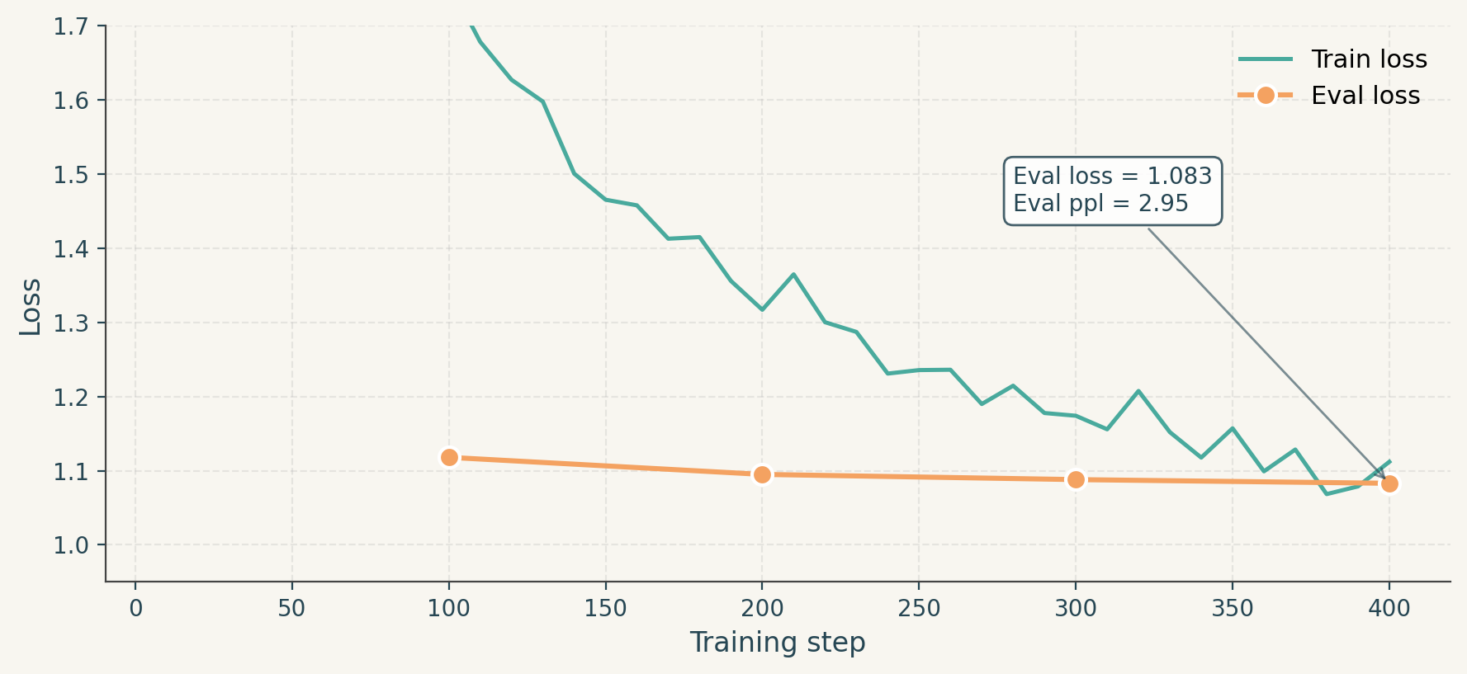

Training setup
TRAIN DESCRIPTION
SFTTrainer config
Training & eval loss
Completion-only loss — only the assistant tokens are scored, not the prompt.
Steps | 400 (~1 epoch over 20K)
Effective batch | 16 (per-device 8 × grad accum 2)
Learning rate | 2e-4, cosine + 5% warmup
Optimizer | paged AdamW 8-bit
Precision | bf16 compute
Max seq length | 512 tokens (covers ~94.5% of data)
LoRA target | all 7 projections per layer
LoRA r / α | 16 / 32, dropout 0.05
Hardware | 1× A100 40GB (~25 min run)
Sharp drop in the first 100 steps as the model learns recipe format; slower vocabulary refinement after that. No overfit at 400 steps.
QLoRA Recipe Chef | Machine Learning II — Final Project
8 / 16

Slide 9
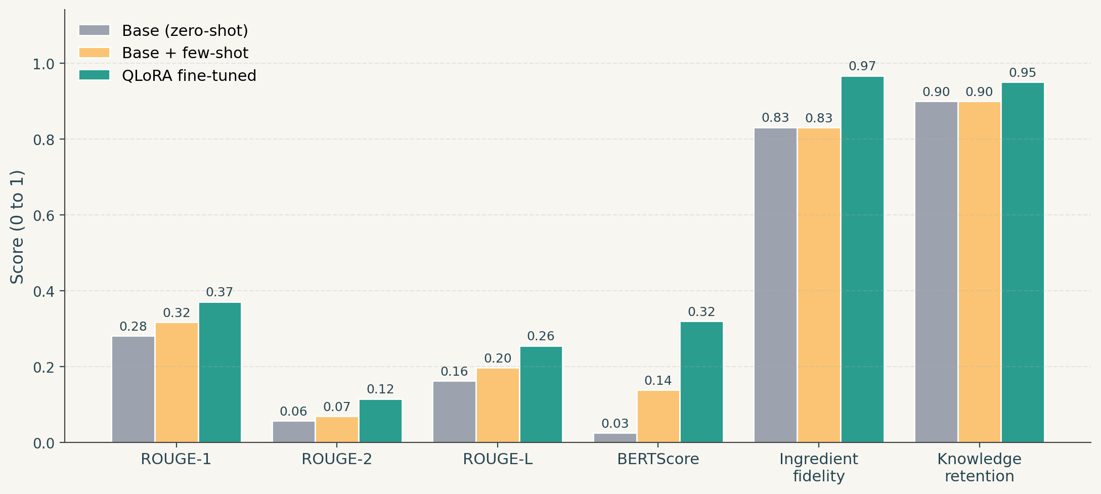
Results — 6 metrics, 3 systems, 50 test recipes
TRAIN/TEST RESULTS
How to read this
ROUGE jumps a lot
Fine-tune learns the recipe format and vocabulary.
BERTScore — 12× gain
Big semantic alignment improvement over the base model.
Ingredient fidelity 0.97
Where fine-tune cleanly beats few-shot — base wanders off-prompt.
Retention preserved
Knowledge accuracy actually went UP (90% → 95%).
BONUS METRIC: Perplexity on held-out recipes drops 12.20 → 2.72 (−77.7%) — model assigns much higher probability to real recipe text.
QLoRA Recipe Chef | Machine Learning II — Final Project
9 / 16

Slide 10
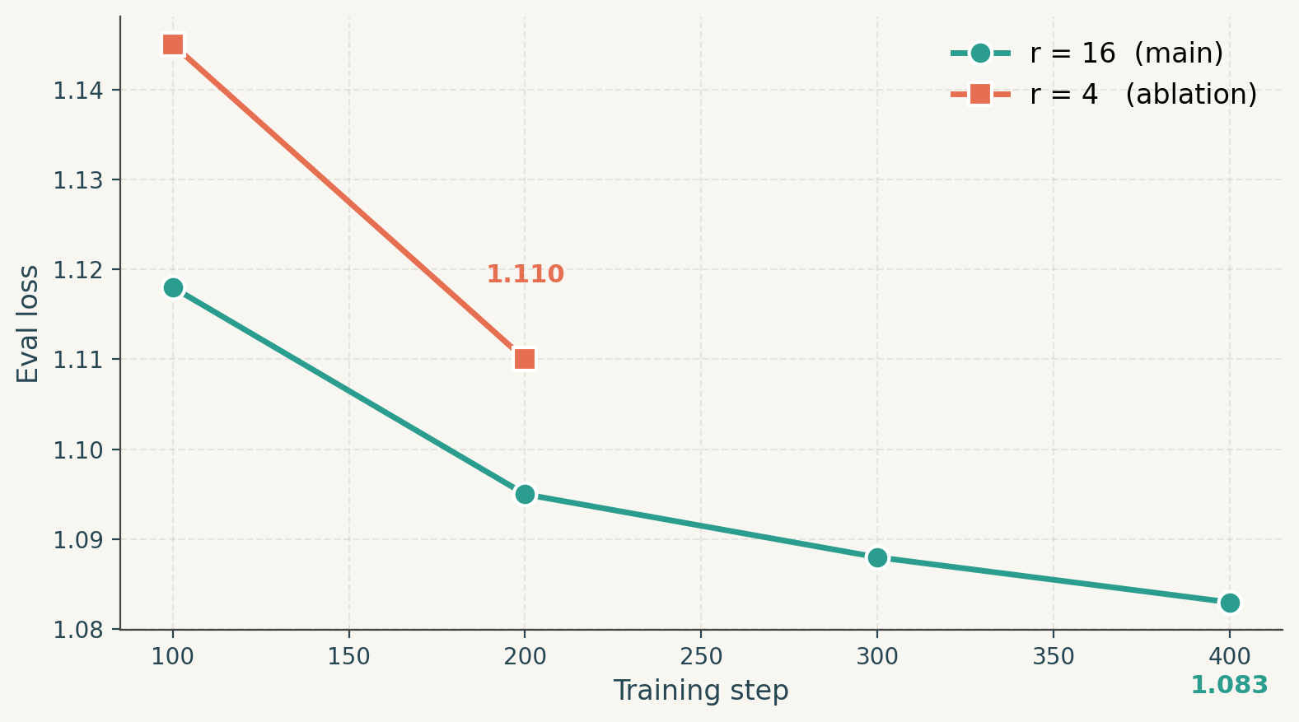
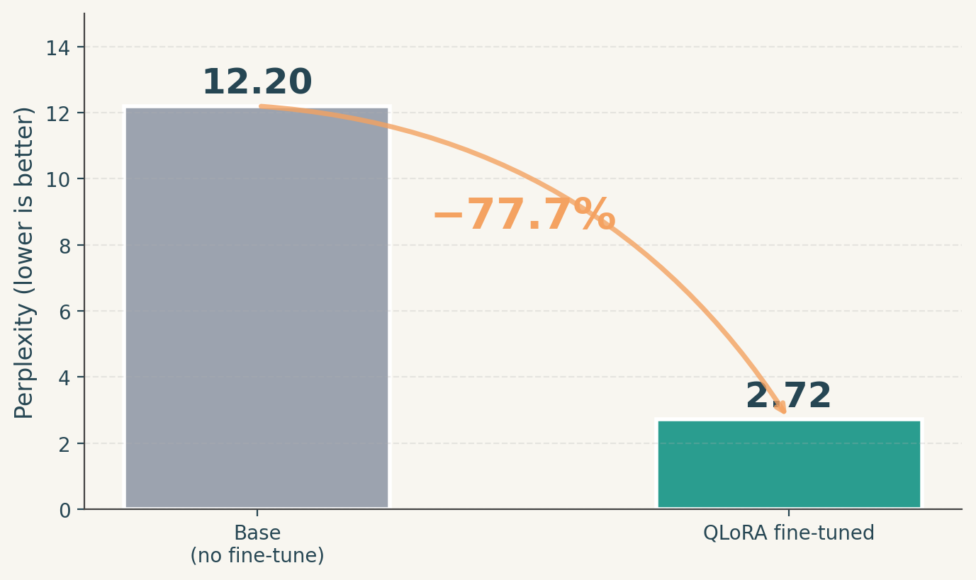
Ablation — does the rank choice matter?
TRAIN/TEST RESULTS
LoRA rank ablation: r=16 vs r=4
Perplexity on held-out recipes
Same data, same hyperparameters — only rank differs.
77.7% reduction — model strongly prefers real recipe text.
TAKEAWAY: r=16 wins (1.083 vs 1.110 eval loss) but r=4 is competitive. LoRA is robust to rank choice within a wide range — useful for compute-constrained settings.
QLoRA Recipe Chef | Machine Learning II — Final Project
10 / 16

Slide 11
Qualitative comparison — base vs fine-tuned
TRAIN/TEST RESULTS
PROMPT: chicken breast, garlic, lemon, rosemary, olive oil | Cuisine: Mediterranean | Diet: omnivore
BASE MODEL (zero-shot)
FINE-TUNED (ours)
**Title:** Lemon Garlic Rosemary Chicken
**Ingredient List:**
- 2 boneless, skinless chicken breasts - 4 cloves garlic (minced) - Juice from 1 lemon - 2 sprigs fresh rosemary - 3 tablespoons extra virgin olive oil - Salt and pepper to taste
**Step-by-Step Directions:**
1. **Preheat Oven**: Set your oven to 375°F (190°C).
2. **Prepare Ingredients**: In a small bowl, mix together minced garlic, lemon juice, and olive oil…
Title: Lemon Rosemary Chicken
Ingredients:
- chicken breast - olive oil - garlic - rosemary - lemon
Directions:
- Heat oven to 375 degrees F (190 degrees C). Place chicken in a roasting pan; season with salt and pepper. Combine lemon juice, garlic, and rosemary in a small bowl; brush over chicken. Roast until juices run clear when pierced with a fork, about 45 minutes.
Fine-tuned model produces the exact Title / Ingredients / Directions format. Base model defaults to Markdown headers, longer prose, and more verbose steps.
QLoRA Recipe Chef | Machine Learning II — Final Project
11 / 16

Slide 12
Deployment
DEPLOYMENT
Three deployment paths from a 30 MB adapter file:
PRODUCTION INFERENCE
1
Local Python
Three lines to load.
PeftModel.from_pretrained(base, adapter_dir) — one line to load. Reusable inference function recipe_chef() wraps it.
from peft import PeftModel
from transformers import (AutoModelForCausalLM,
AutoTokenizer, BitsAndBytesConfig)
bnb = BitsAndBytesConfig(
load_in_4bit=True,
bnb_4bit_quant_type='nf4',
bnb_4bit_use_double_quant=True,
bnb_4bit_compute_dtype='bfloat16')
tok = AutoTokenizer.from_pretrained(
'Qwen/Qwen2.5-1.5B-Instruct')
base = AutoModelForCausalLM.from_pretrained(
'Qwen/Qwen2.5-1.5B-Instruct',
quantization_config=bnb,
device_map='auto')
# Load OUR adapter
model = PeftModel.from_pretrained(
base, 'user/recipe-chef-qlora')
2
Hugging Face Hub
push_to_hub() — three lines. Auto-generated model card (§12.1) includes usage code and our eval numbers.
3
Gradio web app
Interactive UI with ingredient input, cuisine/diet dropdowns, side-by-side base vs fine-tuned, and live ingredient-fidelity score.
QLoRA Recipe Chef | Machine Learning II — Final Project
12 / 16

Slide 13
App demo — Gradio web UI
APP DEMO
qlora-recipe.gradio.app
Recipe Chef
A QLoRA-fine-tuned Qwen 2.5-1.5B that turns ingredients into structured recipes
Ingredients (comma-separated)
QLoRA fine-tuned
chicken breast, garlic, lemon, rosemary, olive oil
Title: Lemon Rosemary Chicken
Ingredients:
- chicken breast
- olive oil
- garlic
- rosemary
- lemon
Directions:
- Heat oven to 375°F. Place chicken in roasting pan; season; combine ingredients; roast until juices run clear.
Cuisine
Diet
Mediterranean ▾
omnivore ▾
☑ Compare with base model ☐ Creative (sample T=0.7)
▶ GENERATE
Ingredient fidelity: 100%
DEMO LINK
QLoRA Recipe Chef | Machine Learning II — Final Project
13 / 16

Slide 14
Requirements
REQUIREMENTS
HARDWARE
SOFTWARE (pinned)
ENGINEERING
Minimum:
1× GPU, ≥ 12 GB VRAM (free Colab T4)
Recommended:
1× A100 40 GB (used here)
Measured run:
4.2 GB peak VRAM
~25 min training
~30 MB adapter checkpoint
python 3.12
torch 2.10
transformers 4.46.3
peft 0.13.2
trl 0.12.2
bitsandbytes 0.49.2+
accelerate 1.13
datasets ≥ 2.20
evaluate ≥ 0.4
gradio ≥ 4.40
Drive-backed caching:
every expensive step writes its output to a shared Drive folder. If Colab dies mid-run, next session loads from cache and skips work that finished.
First full run:
~90 min on T4 / ~25 min on A100
Cached re-run:
~5 min (just loads results)
Single pinned install cell + version-check cell at the top of the notebook makes the environment reproducible on a fresh Colab runtime in 3–5 minutes.
QLoRA Recipe Chef | Machine Learning II — Final Project
14 / 16

Slide 15
Conclusions
CONCLUSIONS
WHAT WORKED
LIMITATIONS (honest)
✓
QLoRA memory pitch is real
• Dietary conditioning is weak — the model still includes cheese in "vegan" outputs.
• Cuisine conditioning is partial — Italian vs Mexican can produce nearly identical output.
• Noisy rule-based labels — keyword spotting is a crude tagger.
• Demo-scale training — 20K examples / 400 steps; not state-of-the-art.
4.2 GB measured vs ~30+ GB for full FT. Free Colab T4 is enough.
✓
Strong gains on all 5 metrics
ROUGE-L +58%, BERTScore +0.30, perplexity −77.7%, fidelity 0.83 → 0.97.
✓
No catastrophic forgetting
General knowledge retention actually IMPROVED (90% → 95%).
FUTURE WORK
✓
Fine-tune beats few-shot
• Curated cuisine taxonomy (LLM-as-labeler, not keywords).
• Scale up to the full 2M dataset with 3 epochs.
• DPO / ORPO using paired (good, bad) recipes.
• Multilingual (Spanish, French, Mandarin).
• Image-conditioned (pair with a VLM that reads a fridge photo).
Especially on ingredient fidelity — few-shot still wanders off-prompt.
✓
r=4 is competitive with r=16
LoRA is robust to rank choice — useful for compute-constrained settings.
QLoRA Recipe Chef | Machine Learning II — Final Project
15 / 16

Slide 16




Thank you
Ask us about…
why we picked R=16
how we measured catastrophic forgetting
the Drive-backed caching design
why dietary conditioning underperformed

